Slide 1
How to download and install the Oracle mobile app
June 2023

Slide 2
Important information
Before downloading and installing the ‘Oracle HCM Cloud’ application on your device, it is important to note that Birmingham City Council does not provide technical support for the application or for personal devices.
The council’s Digital Technology Services can only deal with Oracle related technical issues if you are experiencing problems when using a desktop computer or laptop and accessing Oracle via a supported web browser.

Slide 3
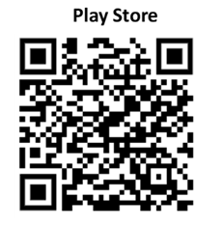
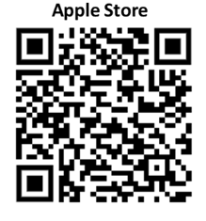
Step 1
On your mobile device, go to where you find and download apps.
If you have an Android device, go to the Play Store
If to have an Apple device, go to the App Store
Search for the ‘Oracle HCM Cloud’ app.
Alternatively you can use one of the appropriate QR Codes below:

Slide 4
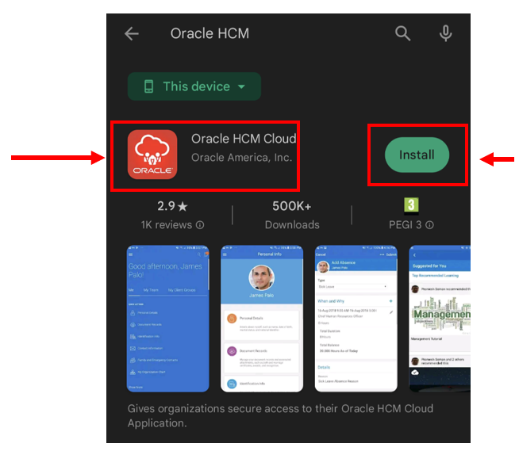
Step 2
‘use the Install button to download and install the app onto the home screen of your device
The ‘Oracle HCM Cloud’ app icon

Slide 5
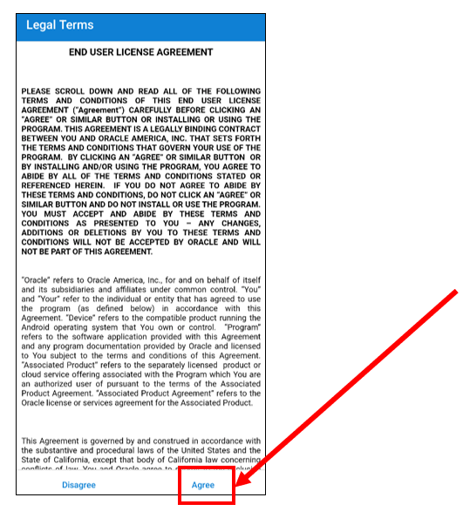
Step 3
Once installed, open the application, and accept the ‘Terms of Service’

Slide 6
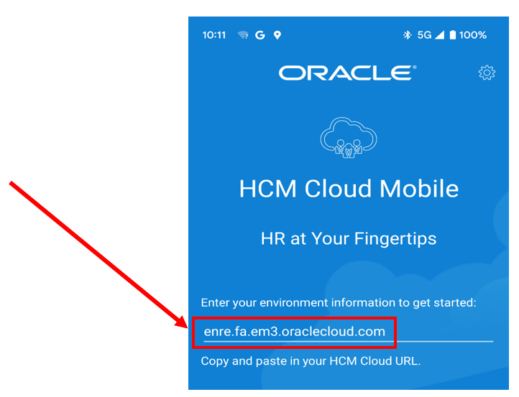
Step 4
Enter this link: enre.fa.em3.oraclecloud.com
.

Slide 7
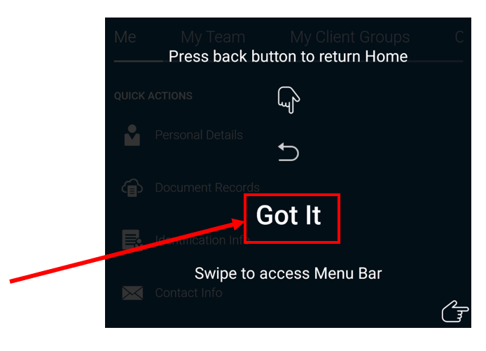
Step 5
When prompted, enter your username and password (your council email address).
  For council staff, this will your council email address
  For schools staff, this will be the email address used to log on to Oracle your desktop computer.
Complete the multifactor authentication process.
Click ‘Got It’ on the black screen

Slide 8
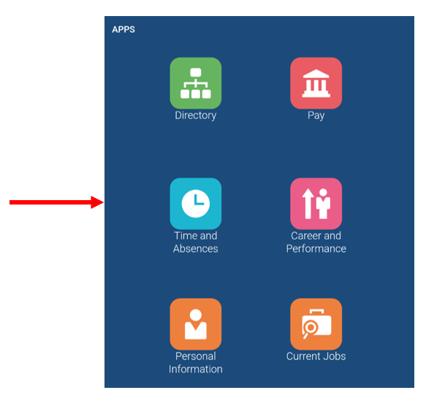
Step 6
You should now see this Oracle home screen, enabling you to scroll through, select and use a range of icons to access information such as online payslips and making leave requests.

