Slide 1
12-15 years COVID-19 Vaccines Webinar for Birmingham schools 15th September 2021
Modupe Omonijo
Public Health Consultant

Slide 2
Introduction
One dose of the Pfizer vaccine to be offered to all 12-15 year olds in England.
Based on advice from the 4 UK Chief Medical Officers (CMOs).
Following an additional study in over 2000 children aged 12-15 years, which generated additional safety and efficacy data, the approval was extended to those in this age group in June 2021. (Green Book accessed 14th September 2021)
COVID-19 disease in children is typically mild or asymptomatic.
Ongoing COVID-19 safety measures including isolation has caused disruption to education and affected the mental health and wellbeing of pupils, staff and the wider public.
Overview of slides
12-15 year olds COVID-19 Vaccine Advisory summarised
Local Communications and Engagement Plans
12-15 year olds COVID-19 Vaccine Research Studies

Slide 3
Vaccine Advisory
Joint Committee on Vaccination and Immunisation (JCVI) released a statement regarding full vaccine rollout for this age group following the approval of the Pfizer/BioNTech COVID-19 vaccine for 12-15 year olds by the Medicines and Healthcare products Regulatory Agency (MHRA) on the 4th June 2021
3rd September 2021: The committee is of the opinion that the benefits from vaccination are marginally greater than the potential known harms but acknowledges that there is considerable uncertainty regarding the magnitude of the potential harms. JCVI is constituted with expertise to allow consideration of the health benefits and risks of vaccination and it is not within its remit to incorporate in-depth considerations on wider societal impacts, including educational benefits. The government may wish to seek further views on the wider societal and educational impacts from the Chief Medical Officers of the 4 nations, with representation from JCVI in these subsequent discussions.”
Chief Medical Officers (CMOs) 13th September 2021
Decision from 4 UK CMOs to advise all 12-15 year olds to receive a COVID-19 vaccine for its short and long term benefits.
Rationale
Effects of Covid-19
Impacts on mental health and disruption to education
JCVI have noted that this decision is not in conflict with their previous advice. rollout to 12-15 year olds would provide both short and long term benefits.
“Additionally to effects of COVID, CMOs considered impacts on mental health and disruption to education as reasoning for their decision. most important in this age group was impact on education. UK CMOs also considered impact on mental health and operational issues. The reduction in public health harm from educational disrupt, on balance provides sufficient extra advantage in addition to that identified by the JVCI.

Slide 4
Global examples and 12-15 years COVID-19 Vaccine studies
Pfizer vaccination - widely used on children and young people aged 12-15 in the USA, Canada and Israel and information from these countries has been used has contributed to the decisions in the UK.
Global research indicated that
Pfizer vaccine is safe and highly effective at preventing COVID-19 cases, hospitalizations and deaths in children aged 12-15 years
Side effects are mild, including pain at the injection site, headaches and fatigue
Myocarditis has been reported as a rare adverse side effect.
Findings from studies: Myocarditis cases per million in adolescents (12-17)
 | Males |  | Females
Covid-19 (Singer, Taub and Kaelber, 2021) | 876 |  | 213
mRNA Vaccines (Bozkurt, Kamat and Hotez, 2021) | 1st dose | 2nd dose | 1st dose | 2nd dose
 | 9.8 | 66.7 | 1.1 | 9.1

Slide 5
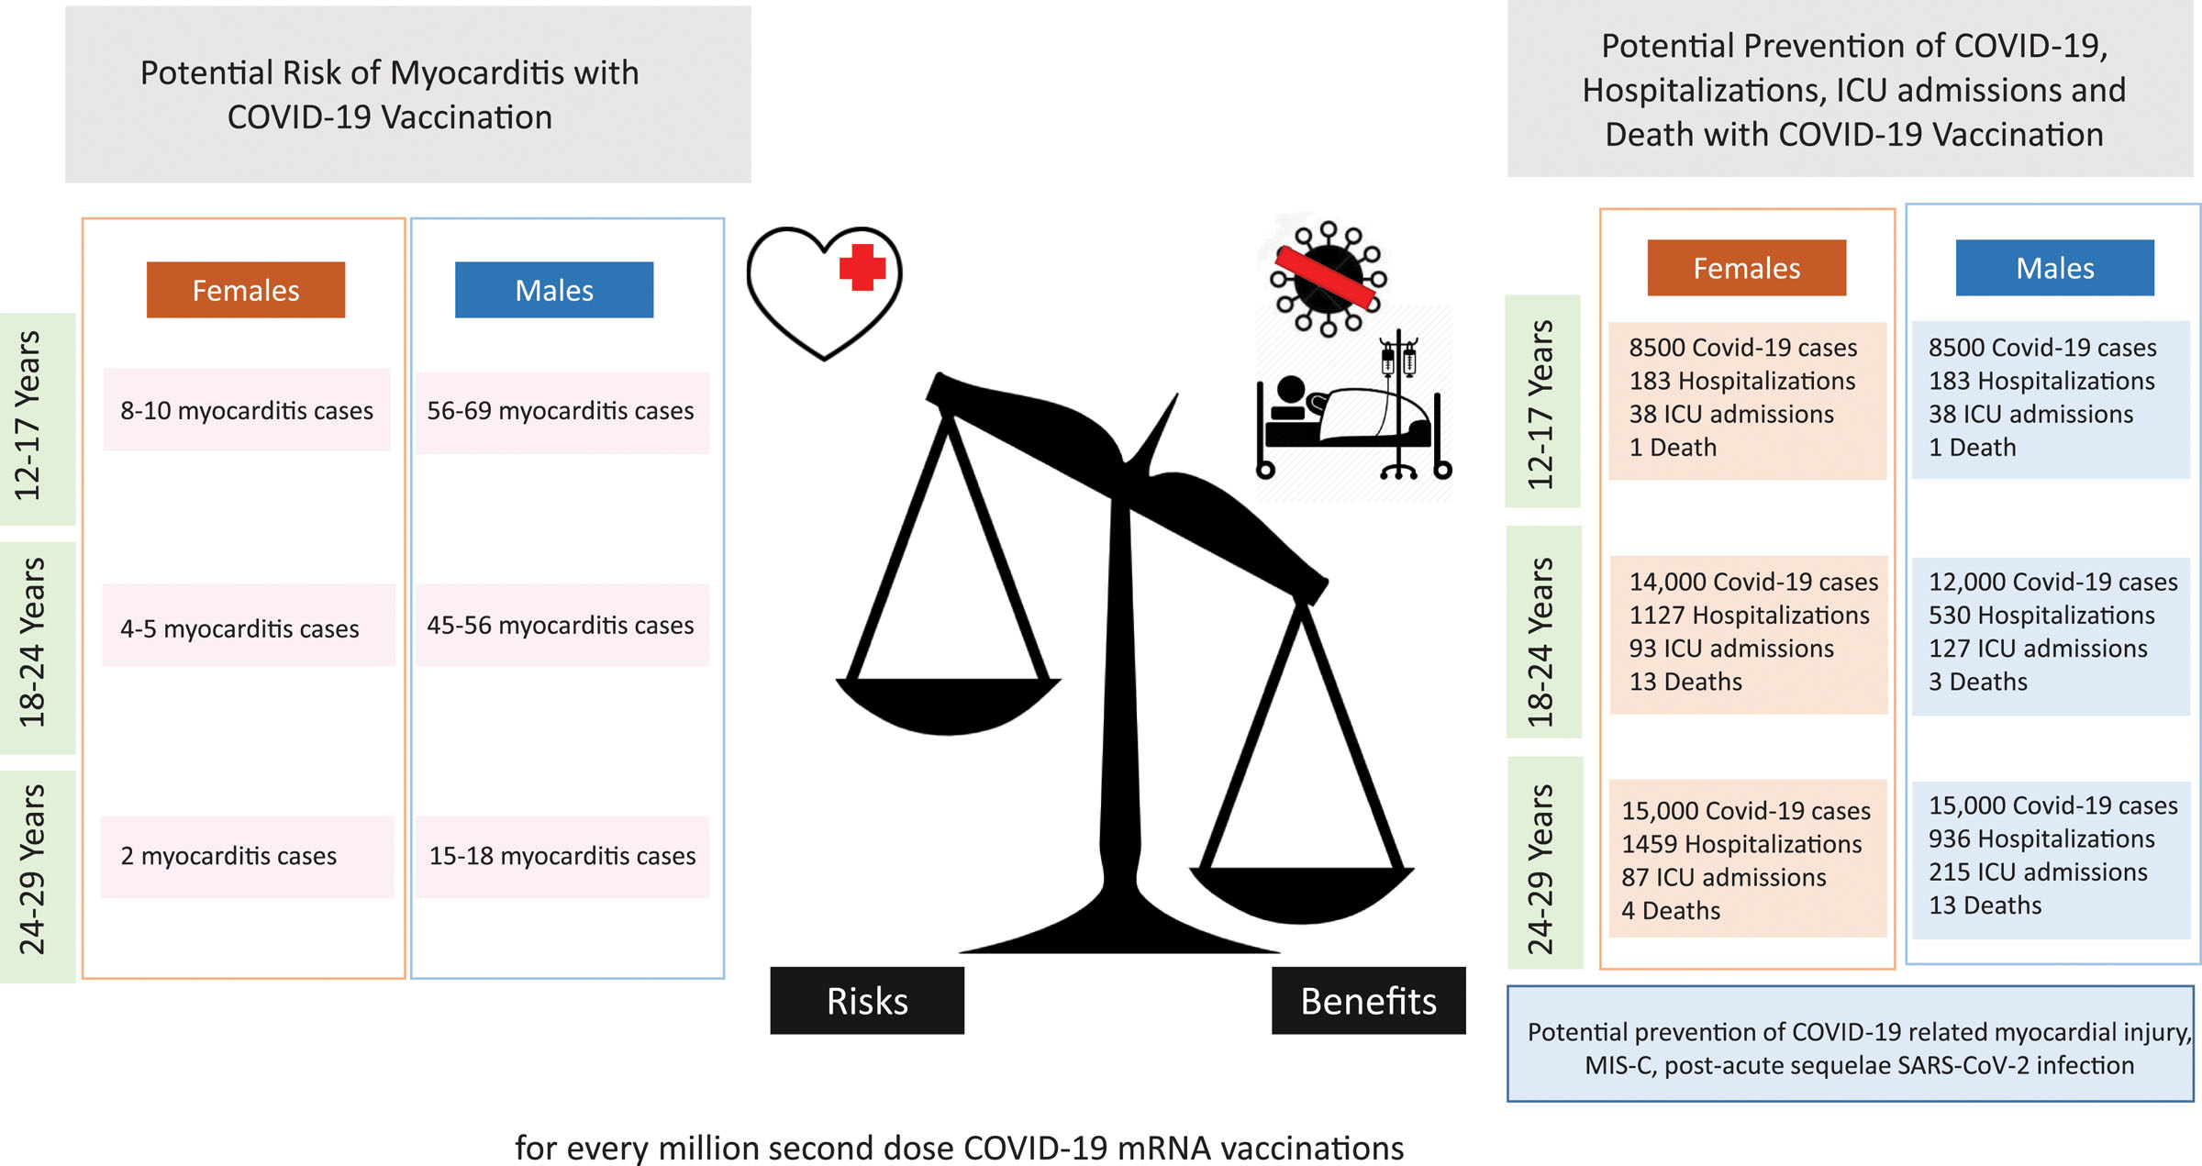
Predicted benefits of reduction in COVID-19–related hospitalizations and death and risks of myocarditis after second dose of mRNA COVID-19 vaccination by age group
Bozkurt, Kamat and Hotez, 2021

Slide 6
Next steps and Local support
UK CMOs Advisory recommends
issues with consent taking into account the more balanced risk-benefit.
Royal Colleges and other professional groups are consulted to advise on how best to present the risk-benefit decisions in an accessible way to children and young people and their parents.
Priority: A child-centred approach to communication and deployment of the vaccine.
Importance of children and young people aged 12 to 15 and their parents being supported in their decisions, whatever decisions they take, and are not stigmatised either for accepting, or not accepting, the vaccination offer.
Individual choice should be respected.
Local Plans
Joint BSOL letter for parents.
Continue targeted local engagement and communication via Youth and Community champions and other key stakeholders.
Public Health England and NHS co-created advice pack shared with schools on COVID-19 vaccination: A guide for children a young people
Provide evidence and credible facts to support informed decision making.
To read more about vaccine safety, please see other statements by JCVI and WHO.

Slide 7
Feedback from a Youth Champions Vaccine Discussion (held in school)
Consent process for COVID-19 vaccine shared by vaccine Minister Nadhim Zahawi
Vaccination is not compulsory and can only take place where there is consent to do so
Information will be made available to help children and parents/carers to make this decision, and children cannot be vaccinated without this consent
This consent can only be given by a parent/carer (or the child where they are able to make this decision for themselves).
Vaccine Acceptance
All 30 young people agreed that they would take the vaccine if offered.
Possible barriers to vaccination
Access as not yet approved.
Parental approval
One champion doesn’t want parental permission to be required to get the vaccine.

Slide 8
CHILDREN’S COVID VACCINATION DELIVERY MODEL
15th Sept 2021

Slide 9
NHS Plan
Delivery with SAIS experienced in running sessions in schools
School based model planned to start on 29th September
Consent forms and information leaflets for parents and children will be sent to school one week prior to the visit
Schools will be contacted by the provider to book the sessions in
Support will be needed in terms of set up of venues prior to attendance and this will be communicated at the time of booking
Further information will be shared when confirmed

Slide 10
Social media final slide

