Slide 1


Birmingham City Centre
2018 Street Trading Review and Improvement Strategy
Draft Study Report
The Retail Group
September 2018

Slide 2
Contents
Page
1.0 Introduction 3
2.0 Objectives 5
3.0 Retail Review 7
4.0 Stakeholder Survey 12
5.0 Trader Survey 24
6.0 Additional Study References 29
7.0 Conclusions 32
8.0 Recommended Improvement Strategy 35
Appendices
I Stakeholder Survey
II Operator Survey

Slide 3
Introduction

Slide 4
1.0 Introduction
1.1 Background to The Retail Group (TRG)
1.2 Background to Project
The Retail Group is a management consultancy, which specialises in the wider retail sector. We work for a variety of clients that are active in the retail, markets, location and consumer shopper sector. We help our clients to maximise retail performance through a detailed understanding of the consumer, their shopping requirements and the opportunities to improve a retail offer to satisfy more requirements more of the time.
We work for local authorities, town centre managers, BIDs, retailers (large and small), as well as retail property clients including landlords and developers and other ‘non-traditional’ retailers such as visitor attractions, hotels, caterers and brands.
We have worked for retailers across the retail spectrum, projects include developing new concepts, improving short term performance, creating new strategies and developing bespoke training solutions.
We are the leading independent markets consultancy in the UK.
We are regular advisors to the National Market Traders Federation. We sit on the All Party Parliamentary Group for Markets.
We have worked on many of the UK’s leading open street and covered markets, including Portobello Road, Petticoat Lane,
Roman Road, Whitechapel, Winchester, Newcastle Grainger, Manchester Arndale, Oxford Historic Market and Nottingham Victoria Market.
We have also worked extensively for Westminster City Council, advising them on how to improve street trading in the West End of London.
Birmingham City Centre has recently undergone and continues to go through significant change and improvement, with the opening of the Grand Central and extension of the Midland Metro transport system.
The centre is also being affected currently by the relocation of Primark from Union Street to the old Pavilion Shopping Centre on High Street. Going forward, the city will be hosting the 2022 Commonwealth Games, bringing a further impetus to upgrade and improve the city centre.
With the above in mind, the city council are looking to improve the overall environment and experience of the city centre.
The aim of this study is to assess the existing city centre street trading offer and make recommendations on how it can be improved, to compliment the wider aspirations for the city centre. This study will bring up to date the outputs of the study completed in 2011.

Slide 5
Objectives

Slide 6
2.0 Objectives
2.1 Objectives
To update the 2011 review of street trading in Birmingham City Centre
To engage with a wide variety of city centre stakeholders, including street traders
To update the opportunities to improve the street trading in the city centre, in the context of the future city centre retail offer and trading environment
Where are appropriate locations going forward, given the changing city centre retail dynamic, as well as longer term aspirations?
What should be sold, and where / how, to most benefit consumers
What is the optimum mix of categories and trader numbers within the city centre, to satisfy consumer demand?
How should the street trading units look, to fit in with aspirations for the city centre
The improvements needed to ensure the street traders are managed more effectively at a strategic level, and how might they be supported to improve their performance
To update the previous methodology and to refresh the outputs and recommendations

Slide 7
Retail Review

Slide 8
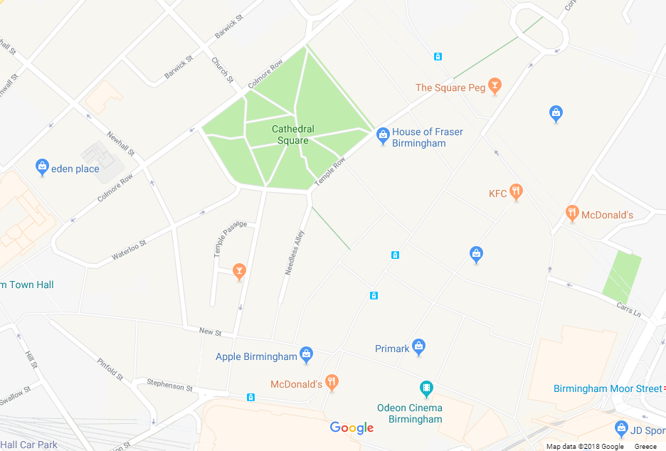

3.0 Retail Review
3.1 Introduction
An assessment of the existing street trading offer has been undertaken from the perspective of the consumer.
This includes the look and feel of the stalls, quality of retail standards, quality of product, relevance of product to journey / trip, customer service, location, sightlines and format / condition of stall.
For ease of reference (given the geographic spread of stalls), the review has been broken down into three zones as shown in the map opposite.
C
C
A
B

Slide 9
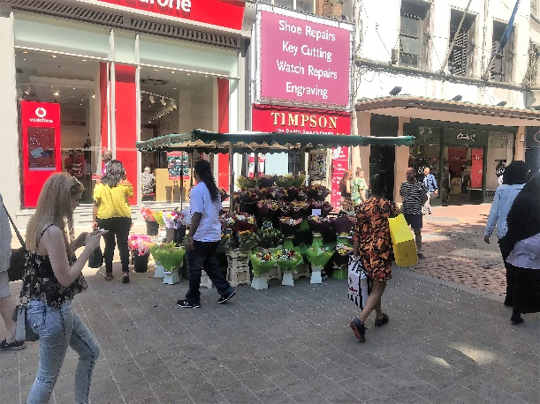
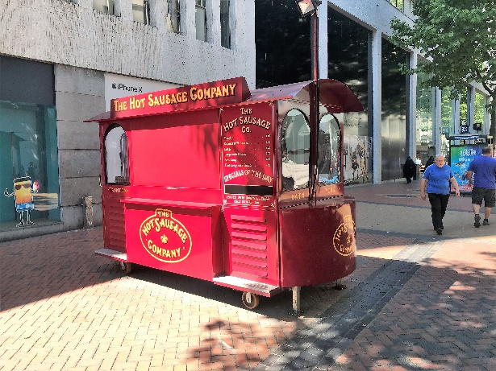
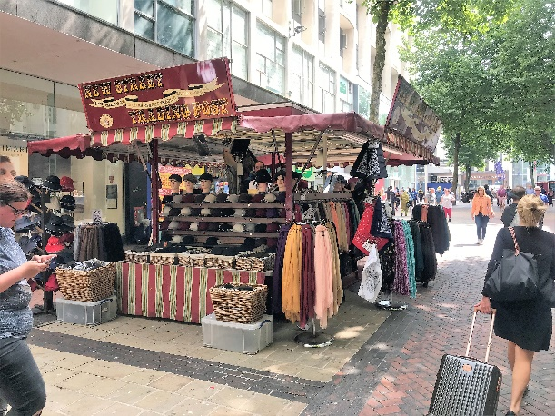
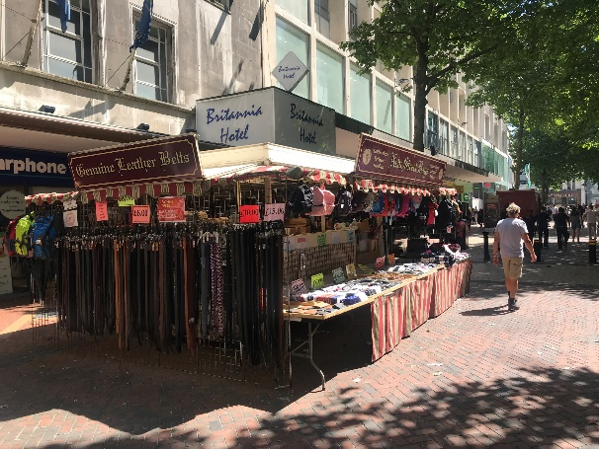
3.0 Retail Review
3.2 Zone A – New Street
There are seven licensed pitches on New Street. At the time of the reviews, two were not actively trading, one due to construction works on Victoria Square and the other unfortunately due to ill health we understand (Lower Temple Street).
The flower stall by Vodafone (junction of Corporation Street) is an attractive and appealing addition to the city’s retail landscape.
In the centre of New Street however, the two luggage / bag and clothing stalls are in poor physical condition, too big, and detract from the surrounding retail offer. The product quality on offer is also poor and the stalls appear unwelcoming due to presentation and lighting levels.
The hot dog stall (outside Carphone Warehouse) trades from a well made, well kept and purpose built stall and appears popular with consumers.

Slide 10
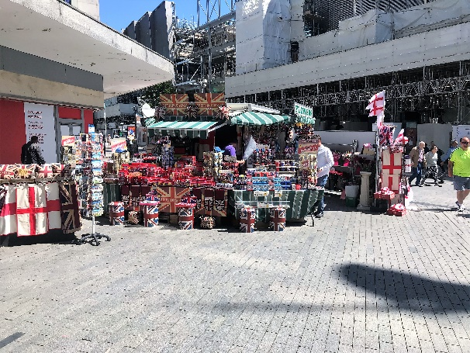
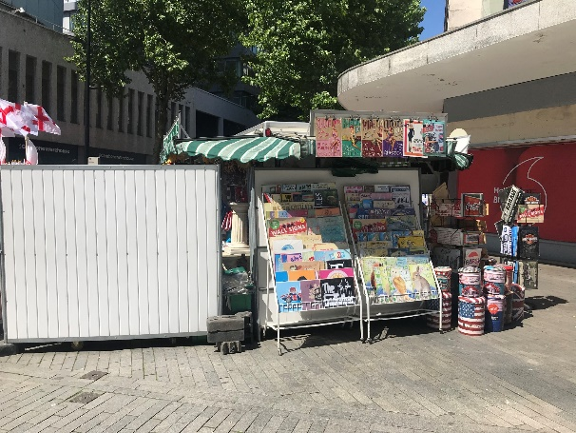
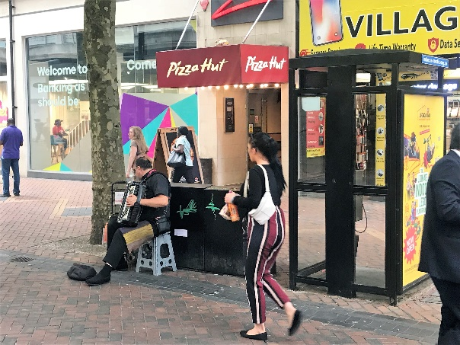
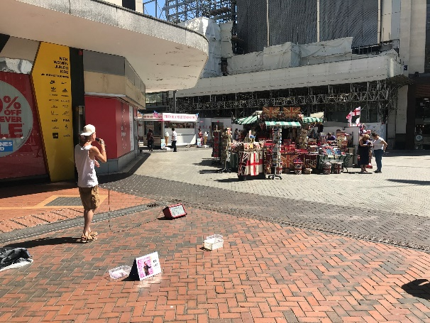
3.0 Retail Review
3.2 Zone A – New Street contd.
The stall at the bottom of New Street where it joins High Street is located in the middle of very high levels of footfall flows. It has a sprawling product range and is also blocking vista’s down these premium retail locations.
It is also worth pointing out that New Street offers shoppers a very poor retail experience as a result of the sheer volume of pedestrian interference. This includes preachers, chuggers, buskers with amplified music, beggars, street drinkers and peddlers.
These all combine to create an intimidating and unpleasant retail environment and provide a retail experience way below what one of the premium retail streets in the UK’s second city should be delivering.

Slide 11
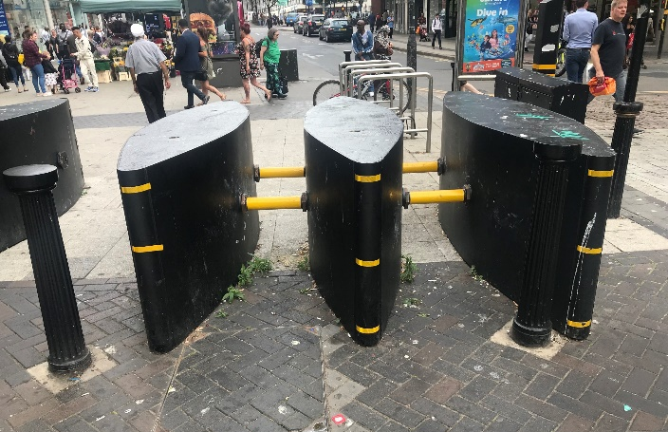
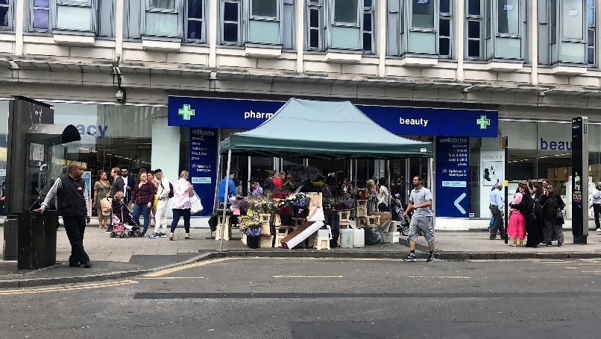
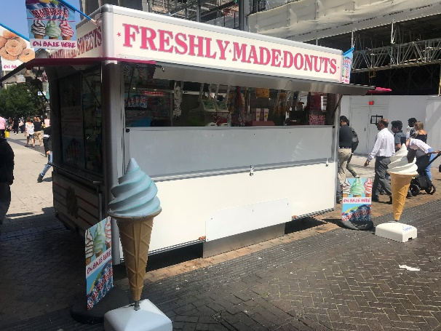
3.0 Retail Review
3.3 Zone B – High Street
Although there are three licenced pitches on the High Street, only two of them are currently active. One sells doughnuts and ice-cream from a purpose built, well lit stall. Although this is a new, well maintained stall, it is not in a great location as it is blocking a footfall route. The other is a flower stall, which is located directly outside the entrance to Boots at the northern end of High Street, on the narrow part of the pavement. This is a very poor location for street trading and one that is causing significant interference to shoppers and a major city centre anchor.
Whilst the environmental appeal of High Street is currently reduced because of the construction of the new Primark store, this is temporary and will stop once the store opens in December this year.
In the meantime, High Street suffers from the same active levels of pedestrian interference as New Street, with excessive levels of chuggers, beggars, peddlers, buskers and litter, especially around the security barriers.
They all combine to create a poor retail experience and given how positive an experience the covered nearby retail centres provide (Bullring, Grand Central, Mailbox) this is an issue that needs addressing urgently.

Slide 12
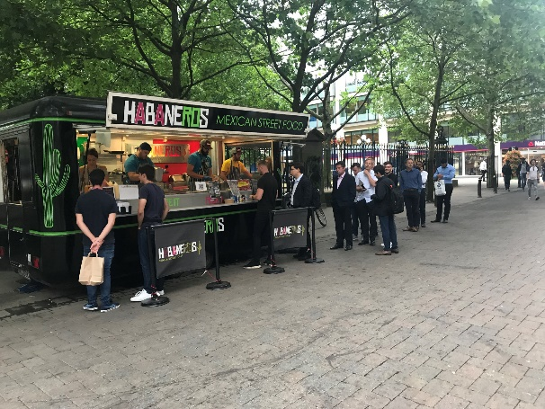
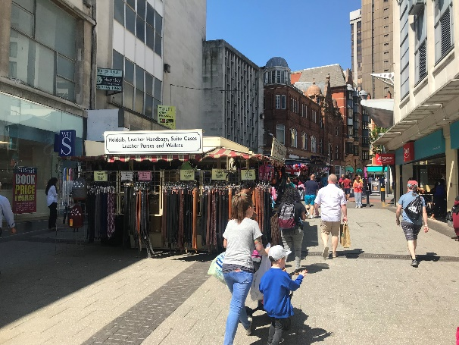
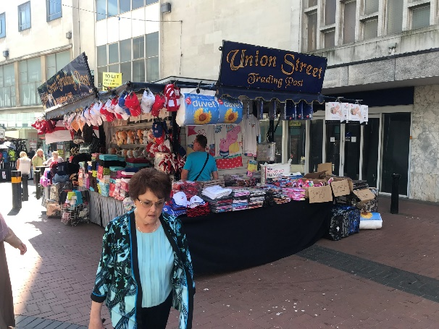
3.0 Retail Review
3.4 Zone C - Union Street / Temple Row
The lower half of Union Street has two poor quality stalls selling cheap scarves and bags (albeit with good levels of customer interaction and service).
There is also a currently vacant pitch at the bottom of Union Street / junction with High Street which we understand is due to be actively trading again soon.
On the other side of Corporation Street (and sadly next to the House of Fraser store soon to close) are two very good examples of a street trading offer in tune with customer demand, i.e. good quality hot food targeted at office workers.
Both stalls are well maintained and well delivered and offer a good quality product. The long queues at lunchtime are testament to customer satisfaction.
A similar story can be found on Colmore Row with an excellent example of a good quality flower stall very well delivered. Again, the stall appears popular with consumers and although the stall is near to the entrance of a J Sainsbury Local store, the size of the stall ensures no impediment is being caused to the entrance.

Slide 13
3.0 Retail Review Summary
3.5 Summary
Strengths & Positives | Issues & Negatives
A few good traders A couple of well located stalls Visibly popular with workers with a targeted offer Consolidated to a few areas of the city centre Independent operators | Stalls blocking access and sight lines Poorly located stalls Oversized and poorly maintained stalls Disparate standards of presentation Limited customer service / engagement Difficult to use and shop Confusing offers (product offer) Perceived low quality Limited impact Unable to achieve ‘share of voice’ Litter collection points

Slide 14
Stakeholder Survey

Slide 15
4.0 Stakeholder Survey
4.1 Introduction
Birmingham City Council is keen to ensure the views and opinions of key city centre stakeholders are included within the study. In particular, how key city centre stakeholders would like to improve the existing street trading offer going forward, how the offer needs to grow and evolve in order to play a relevant and beneficial role in what is an improving city centre retail offer and environment.
The Retail Group has developed a questionnaire prompt which was used face to face, over the telephone and as a self-complete survey online.
A copy of the question used in the stakeholder survey is attached as Appendix A.
This section of the report contains the results of consultations with two groups of stakeholders invited to contribute to this report, namely key internal council officers, as well as key external city centre stakeholders.
The council project team supplied a list of 11 internal council stakeholders (with a city centre remit) and they were invited to contribute their views and opinions of street trading to the project.
In addition, the council invited Retail Birmingham to supply a list of external stakeholders, including board members, retail managers and representatives of key landlords in the city centre to take part in the research. A list of 23 contacts was supplied and were invited to take part. Two waves of follow up emails were issued to ensure everyone had the chance to participate.
In total the stakeholder survey achieved a very good response from stakeholders, with 19 responses on line and two responses completed in one to one discussions face to face and over the phone. Individual confidentiality was pledged and the responses have only been analysed collectively.
A list of respondents is detailed overleaf. In addition two respondents to the online survey opted to remain anonymous.

Slide 16
4.0 Stakeholder Survey
4.2 Respondents to the Stakeholder Survey
Amanda Prosser-Davies | Birmingham City Council
Chris Neville | Birmingham City Council
H Burnett | Birmingham City Council
Janet Bradley | Birmingham City Council
Mahendra Chauhan | Birmingham City Council
Sajeela Naseer | Birmingham City Council
Simon Hughes | Birmingham City council
Stuart Wiltshire | Birmingham City Council
Rachel Arkell | Boots UK
Martin McCormack | JD Sports Fashion Plc
Lisa Williams | John Lewis
David Pardoe | Mailbox
Alex Coley | M&S
Paul Chittim | Primark
Eddie Gardener | Sainsbury's Martineau Place
Roger Walker | Specsavers
[anon] | Timpsons
Daniel Brown | Watches of Switzerland
D Alvery | [no company]

Slide 17
4.0 Stakeholder Survey
4.3 Summary of Responses
What ‘contact’ do you have with street trading in the city centre?
Contact with street trading is mixed; a combination of those who work directly with street trading and those whose interaction is based on the location of the stalls (e.g. near their shop) and those who have little contact other than when they pass through the city centre
Which existing stalls would you class as good examples and why?
The majority of respondents identified examples. Common examples were flower stalls (New Street and Colmore Row) and also Haberneros
Two mentioned baked potatoes
Reasons focused on the quality of goods and standards of presentation, with one reference to queue management being good and not impeding access or visibility
Several respondents felt there were no good examples
Potato man on Temple St - good product and attractive van
Florist on New Street- always looks well merchandised
The Mexican street food stall behind House of Fraser because of its appearance
Unfortunately I can't recommend any as not sure I have ever noticed a very good example

Slide 18
4.0 Stakeholder Survey
4.3 Summary of Responses contd.
Which would you say are not so good and why?
19 provided a poor example
Comments related to traders in general along Union Street, New Street and High Street
Specific examples included; mobile snack unit (adjacent to Moor St Station), leather goods and bedding / towel traders in New Street (near the Odeon) and in Union Street, unit on corner of High Street / New Street, hotdog and donut stands and memorabilia trader (by Vodafone)
Pedlars and religious preachers also mentioned
Reasons included poor quality products, untidy, poor standards of presentation, obstructing visibility and access, noise and food generating bad odours
Unprofessional and out of keeping with the role and profile of the city centre and / or location
Leather goods and bedding / towel sellers in New Street near the Odeon and in Union Street because they look like jumble sales
Towel stall on Union Street - Looks unattractive, it is directly in the middle of a walkway, has spread out too much
All of the tat market stalls in New Street and Union Street - these look cheap, tacky, are too big and block the street
Leather goods - Cheap and poor quality

Slide 19
4.0 Stakeholder Survey
4.3 Summary of Responses contd.
What positive benefits do street traders bring to the city centre?
20 responses received
Most do see the benefits – only 5 do not
Add vibrancy and character
Generate footfall
Variety and diversity
Lower prices and independent traders
Caveat ‘if done correctly’
Response received for a preference to be in the ‘market areas’ not prime retail, with exception of a few selected food stalls only
Vibrancy - an independent alternative to the mainstream offer - breaks up large spaces
Street trading is world wide, people like it and expect it. At its best it provides a great place to buy essentials and impulse sales
Adds character if done correctly
Nothing at the moment!

Slide 20
4.0 Stakeholder Survey
4.3 Summary of Responses contd.
What negatives do they generate?
21 responses received
Only two stated none
Issues mentioned focus on the poor quality image they project, including goods sold and standards of presentation
They also seem to create problems in terms of visibility, access and customer flow
Devalues and detracts from the city centre
Additional issues include odour, litter and shouting
Size also appears to be an issue, taking up too much room and / or disproportionate to the space they are in
Considered to be causing street clutter by some
Poor quality and service lowers customers perception of the whole area and surrounding retailers
They can (and some do) impede the highway in areas where there really isn't enough room for them
They look tatty, sell rubbish, block the street and give a really downmarket look to the city centre
Bad odour, litter, shouting

Slide 21
4.0 Stakeholder Survey
4.3 Summary of Responses contd.
If you could change one or two key aspects about them, what would that be?
“Better quality items” “Consistent placement” “No loud speakers or microphones” “Uniformity in design” “Location - the city has markets” “Appearance (more uniform) for recognition” “They should not be allowed in roads or streets where there is insufficient space for them and pedestrians to coexist, e.g. in Union Street” “I would not change much, during the quiet times the units may benefit from a coat of paint and bright LED lighting” “Have fixed units” “Amount of space they take up in the prime locations” “Stricter conditions that are rigorously enforced” “Remove all stalls that cause an obstruction” “Get rid of all the market stalls and make any new trader have a fixed, properly maintained SMALL kiosk” “Confine street trading to street food and flowers” “Make them keep to their barrows” “Space them out better - it can get congested” “Open longer” “Long term strategy for location” “Location, management, consistency”
Main aspects:
Design
Location
Appearance
Size

Slide 22
4.0 Stakeholder Survey
4.3 Summary of Responses contd.
If you could change one or two key aspects about them, what would that be?
“No hot food” “Gather together” “Well kept stalls” “Range of offer, e.g. different type of food offer (Moroccan or more ‘food festival’)” “Quality and design of the kiosks and policing of their build out” “Quality checks on value, service and viability” “Improve their appearance and be more than a few tables with merchandise that looks like a jumble sale” “Control goods sold” “What they offer - their sale lines” “Define street trading and which activities fall into this definition and those that don’t” “Reduce the size of the stalls to a designated size contained within a purpose built unit that prohibits spreading” “Cheap goods should be moved to the market areas” “Interact with local stores / perhaps offers” “Get more fresh” “That they take their rubbish with them and not stock pile it by the already full bins” “The market stalls in the main shopping streets should be removed to Edgbaston Street with the other market traders - leave only occasional food offers” “Different proposition, fit for purpose”
Other aspects:
Product offer
Maintenance
Regulation
Housekeeping

Slide 23
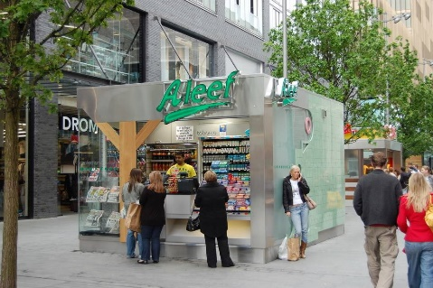
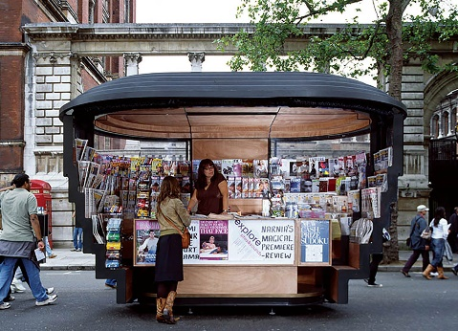
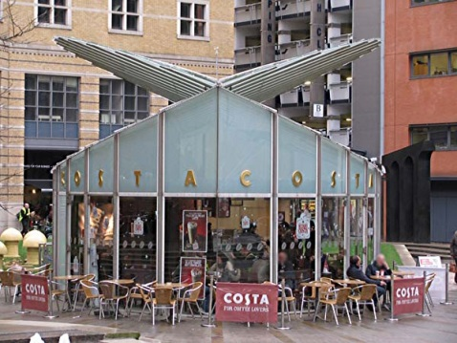
4.0 Stakeholder Survey
4.3 Summary of Responses contd.
Where have you seen other examples of street trading that you liked; what did you like?
London -fresh orange juice. Rome -flower stalls
Farmers markets, Solihull
Bullring Rag Market is like a small town and is a good community, all walks of life
Brindley Place kiosk, paper house kiosks Kensington & Chelsea – quality kiosks
London - uniformity and good quality of goods and service
Bristol - street food everywhere and well used by the local community
Liverpool, Solihull - look good and in bespoke units that don't look out of place
Liverpool City Centre - seem better regulated and managed by enforcement officers
Westfield White City – mall kiosks, designated area
Abroad - where they control it and have dedicated units / kiosks that don't block the street and look a mess and sell quality food / items, not rubbish

Slide 24
4.0 Stakeholder Survey
4.3 Summary of Responses contd.
In your opinion, what would be an ideal street trading kiosk?
Location Open, large space High footfall areas Clustered on the fringe of primary retail area On the street In a cluster Park, green space or square Not in a street blocking pedestrian flow Away from the flagship stores On street corners Back street locations | Product Flowers Fresh produce Food and ‘food to go’ Street food Alternative food More food – especially changing Newsagent items - items consumed on a daily basis Diverse ranges unique to sole traders Preferably interesting food and drink for office workers (lunch) Good quality
Look Bright, attractive, clean, tidy, modern Same as all other trading outlets Modern, consistent form - create a Birmingham kiosk Logo / link to Birmingham City heritage or future Upmarket / stylish Purpose built and attractive Tidy, modern kiosk, well maintained and suitable for the space In keeping with the local public realm design - modern or traditional Smart, a proper Retail Merchandise Unit (RMU) | Construction Recycled materials Metal perhaps clad in other materials to help appearance Glazing Easy clean, vandal-proof material, solid and secure but mobile Form of construction less important than overall appearance Wood and / or metal Glass, painted steel Permanent construction and in appropriate areas Metal / wood

Slide 25
4.0 Stakeholder Survey
4.4 Summary
The stakeholder survey obtained a very good response rate both from internal and external stakeholders.
While stakeholders clearly have concerns over the current street trading offer, they are not opposed to street trading if delivered well and most consider it to be beneficial in a variety of ways.
There is an evident need to clearly define and identify the offer and its trading parameters – is it a market, is it street trading, is it kiosks?
Poor examples outnumbered the good examples – however there are still plenty of good examples. The likelihood is that the majority of traders could be much better and this reduces the overall general perception of the offer.
The better examples are identified because of the quality of their products, trading unit and their standards of presentation. Likewise the poor examples are considered to be offering poor quality products, are untidy in their appearance and projecting an unprofessional image. There are also issues relating to noise, odours and creating an obstruction.
The majority of stakeholders do perceive clear benefits to street trading, ‘if’ delivered well, from adding vibrancy and variety to generating footfall.
Negative aspects are clear and relate to the quality of the delivery both in terms of products and presentation, the negative effect on perceptions of the city centre as a whole and the impact on pedestrian flow, access and visibility.
Aspects to improve fall into two groups; priority aspects relate to design, location, appearance and size. Secondary aspects also to be addressed focus on product offer, maintenance, regulation and housekeeping.
Examples were provided of ‘good benchmarks’ seen elsewhere - but not many. These were typically of fixed, high quality, well designed and no doubt expensive street kiosks. Reasons reflect the views of ‘good’ street trading recorded in other questions; quality of goods, unit format, appearance, designated area and regulated.
The ideal street trading kiosk shares some common factors; modern or traditional but with a consistent look, a link / branding to Birmingham, products that focus on fresh produce and food with ‘good quality’ as standard, materials typically wood or metal with the thorny subject of location a divisive issue - open space, high footfall, secondary location, designated ‘market / street trading area’?

Slide 26
Trader Survey

Slide 27
5.0 Trader Survey
5.1 Introduction
5.3 Typical Customers and Customer Numbers
Birmingham City Council is also keen to ensure the experiences, views and opinions of existing street traders are also taken into account in the project.
A bespoke self-complete survey has been developed for the project.
All existing traders were handed a survey at their stalls to complete. Despite being invited a further two times to participate via the Street Trading Association, only 4 traders shared their views and opinions by completing the survey.
Their experiences and views were shared on a confidential basis and are summarised below.
The majority of their customers fall into two groups; city centre workers and tourists (both international and domestic). Students are also an additional group mentioned.
Customer numbers being served cover a range from 20 to 250 a day.
In most cases customers visit frequently; daily or once / twice a week, with high conversion rates of customers to purchasers 60-100%.
Dependent on the nature of the business the proportion of regulars can be high (80% in one instance).
Current trading experience is split with two traders reporting they are serving more customers than last year and two fewer.
5.2 Respondents
The four traders included in the survey represent both newer traders and longstanding established traders. One trader has been trading in the city centre for 28 years, two for over 10 years and one for between 1 and 5 years.
The location of their stalls includes; High Street, Union Street, Cherry Street and Colmore Row. Product categories sold cover ‘food to go’, flowers and souvenirs.

Slide 28
5.0 Trader Survey
5.4 Trading Patterns
Peak trading patterns vary with some busiest during the week and others at the weekend. Busy times of day are more consistent and focus on lunchtime and the afternoon.
Average transaction values are typically low; less than £5.
Trading fortunes are mixed, reflecting the response to customer numbers. Two traders are trading very well and report sales more than 10% up on last year, while two are trading down on last year (one more than 10%). Reasons for positive trading include, new product lines and a good business, reasons for poor trading included a lack of customers coming into town.
In terms of future outlook next year compared to this year, three of the traders consider trading will be similar next year and one that it will be below.
Traders on the whole rated the current offer positively, rating aspects as good or very good, with the exception of ‘management and policing’ and ‘waste and cleaning’. These two aspects were rated less positively receiving ratings of OK or poor.
Similarly traders were asked to indicate their level of agreement / disagreement with four statements about the offer;
Street trading is successful and improving
Street trading offer is appealing to more shoppers
Street trading offer has broad appeal
I am optimistic about future for street trading.
On the whole the four traders were similarly positive agreeing with the statements in most instances, one trader did not feel it was successful and improving and was ambivalent in regards to the other statements.
5.5 Views and Opinions on Street Trading
Traders were asked to rate the current city centre street trading offer on a number of different attributes:
Appearance Choice and variety Quality of products Location / layout | Footfall generation Management / policing Benefit to adjacent retailers Waste and cleaning

Slide 29
5.0 Trader Survey
5.6 Future Improvements
5.7 Strengths and Weaknesses
Traders were asked how they would like to see the street trading offer improve in the city centre from a tick list of options, their responses are shown below:
This was an open question with responses detailed below.
Strengths:
Location
Value for money
More choice
Excellent catering
“We are friendly ambassadors”.
Weaknesses:
No policing
Moved about too often
No electricity
No protection from buskers and religious groups
Some scruffy units
Some unfriendly traders.
Better marketing and promotion Improved layout & locations Improved management Improved signage | Longer trading hours Better visibility Better access / integration to shops Higher quality stalls
Traders were also asked which product categories they felt were missing or lacking in choice in the city centre street trading offer. Only two responses were received; ‘quality food’ and tourist information / Birmingham souvenirs. With an additional comment from one trader that they act as unofficial tourist information.

Slide 30
5.0 Trader Survey
5.8 Summary
The low response to the survey from the trader community is in itself a finding and indicative of a disconnect between this community and the council / other stakeholders in the city centre. Traders feel threatened.
That said, the responses that were received provided useful insight and are revealing in their own way. Most notably in a number of respects their views were more closely aligned to those of the city centre stakeholders than one may have expected.
Traders identify a customer base dominated by city centre workers and tourists.
Customer numbers are quite varied, from low level (circa 20 per day) to 100, 200 and 300 per day. Visit patterns are frequent, conversion rates are also high. This would indicate a limited customer base who use street traders regularly.
Trading fortunes are mixed – two of the four are trading well and two less so.
Peak trading hours are lunchtime and afternoon with peak trading days variable by business and most likely location.
ATVs as you would expect for market stalls are low, less than £5.
While they are largely positive about the current street trading offer they identify clear room for improvement.
Areas for improvement focus on marketing and promotion but with a variety of other aspects identified, from improved management to higher quality stalls, improved layout and location and better access / integration to shops.
Additional ad hoc comments received from one trader referenced the specific need for rules and regulations to be observed by all traders and the view that the lack of enforcement adversely affects them all.
This trader was also strongly of the view that they were individual businesses and was not keen on being referred to as one, “amorphous group”.

Slide 31
Additional Study References

Slide 32
6.0 Additional Study References
6.1 Street Trading Consumer Research (from The Retail Group 2011 Study)
The Retail Group undertook a review of street trading in Birmingham City Centre in 2011. As part of the project, we interviewed 570 consumers on the street in the city centre in regards to their experiences, views, opinions and improvements wanted in regards street trading. The key findings were as follows:
• Consumers are mainly in the city centre to shop (especially New Street and High Street) or work (near Colmore Row). Workers are also found on New Street and High Street.
• Approximately half of consumers buy from street traders and half don’t
• Main products bought include food and drink, flowers, fashion accessories and bags. Workers mainly buy food and drink (especially hot food).
• Purchases are being bought because of value, convenience and need.
Approximately one quarter of consumers who buy from street traders do so regularly, with the majority buying occasionally
• Of these that don’t buy, this is mainly because of perceived poor quality product, lack of appeal, poor customer service and stalls look poor. Workers are more distrustful than shoppers
• Consumers on the whole want to buy better quality food and drinks, mobile phone top-ups, newspapers / magazines, fruit and veg, flowers / plants and clothing / accessories
• Consumers would buy more if the stalls looked better, sold better quality product and if the products on offer were more suitable to their needs (see previous point)

Slide 33
6.0 Additional Study References
6.2 City Centre Retail Strategy
The Council produced a Retail Strategy for the City Centre in 2015, which aimed to co-ordinate the effects of the various developments underway (Grand Central, Mailbox extension, new Primark in ex Pavilion's Shopping Centre), as well as coordinate the additional opportunities that exist.
The aim is for Birmingham city centre to:
• Be a world class retail destination
• Be more of a visitor destination
• Extend it’s appeal to families
• Have more leisure and entertainment appeal
• Offer an improved food and beverage offer
• Improve the city centre’s retail markets
• Have an improved retail environment and public realm
Furthermore, the strategy highlighted the importance of the city centre offer becoming higher quality, more diverse, with more reasons to use, more exciting, more memorable, safer, offering more events and more of a day out and not just a simple needs based trip.
Specifically, the strategy is clear that the major retail streets of New Street and High Street have a fundamental role in delivering a high quality retail experience, including the ‘nodes’, where the main pedestrian routes co-join and overlap.
In particular for New Street, the strategy envisages a much clearer and more attractive retail space, with less street clutter, improved streetscape, removal of building overhangs above retail facias, removal of advertising and much cleaner retail environment.
This strategy also envisages more pedestrian priority, including more events and more external tables and chairs from restaurants, particularly at the north western end.
The strategy for high street is similar with focus on improved pedestrian environment, especially at the connections to Eastside, Digbeth and the future development of Martineau Galleries.
Following the relocation of the wholesale market from Smithfield, the strategy envisages improved retail markets, more family leisure, more entertainment and complementary retail and residential development. More niche, complementary and themed traders will be encouraged to the retail markets.
It is clear that the strategy aims to provide a vastly improved retail and visitor experience for Birmingham City Centre in the mid to long term future.

Slide 34
Conclusions

Slide 35
7.0 Conclusions
7.1 Introduction
7.2 Street Trading in Context
The aim of this section of the report is to draw together the key findings of the various research work-streams undertaken as part of this study, in order to highlight conclusions. These will be used to provide the bedrock for the recommended future vision for street trading in the city centre, as well as the improvement strategy.
In particular, key conclusions have been drawn in regards:
Street trading in context
Customer need
Existing offer.
Birmingham City Centre has seen huge amounts of change and improvements over the last 15 years. This has been delivered in several stages; each component moving the city centre on in terms of quality of retail offer, appeal and sense of place.
This pace of change is set to further continue over the next couple of years. The impending Commonwealth Games adds further pressure on the need to deliver a world class retail experience. Unfortunately, street trading in the city centre has stayed static and as a result gone backwards in terms of its relative retail appeal. Arguably, in some cases (on New Street and Union Street), it’s actually declined in actual terms of what’s been sold and the receptacle it’s being sold from.
Furthermore, there are some locations, namely the junctions of major streets and footfall routes which are simply not suitable for street trading if the city is to deliver a true twenty first century retail offer.
Having said that however, the street trading offer is often getting the blame for much of what is wrong with Birmingham’s retail experience. In fact, there are many other factors which are influencing the city centre’s reputation as having one of the worst pedestrian retail experiences out of all the leading regional cities in the country. This is a result of a plethora of beggars, chuggers, buskers, peddlers, and street sleepers in the core of the city centre.
To conclude, the city centre is moving on at a pace. Street trading has to significantly up its game if it is to continue to play a part of the improved city centre retail and visitor experience.

Slide 36
7.0 Conclusions
7.3 Consumer Need
7.4 Existing Street Trading Offer
It is clear from the research undertaken as part of the previous street trading study that if done well, consumers like and will use it’s street trading.
Consumers want to buy good quality top up products, especially food and drink. They want to buy it from attractive stalls that look high quality, are well presented and well delivered.
Consumers like the independent nature of street traders and want this to continue and they don’t have a preference to buy major brands or multiple retailer operated street trading stalls.
Consumers use Birmingham City Centre as a result of it’s leading status and experience. The most successful future street trading offer will be one that matches the standards, quality and experience of it’s retail offer.
When it’s delivered well, the existing street trading offer produces an appealing offer that is
well located, popular with consumers and earns it’s place in the heart of the city centre e.g. Colmore Row, Cherry Street, Temple Row etc.
Unfortunately, there are many cases of poor quality or poorly located street trading stalls. Examples of unacceptable street trading includes:
Stalls directly blocking entrances to retail shops
Stalls blocking or interfering with major pedestrian footfall routes, e.g. junction of New Street and High Street
Poor quality stalls in the highest profile retail streets, e.g. New Street and High Street
Stalls with products spilling onto the pavement, considerably encroaching the space outside the licensed and defined pitch
Stalls with sprawling product ranges often removed or very loosely connected to the original core licensed groups.
If street trading is to continue in the core of the city centre, the premium streets have to have the best stalls selling the best products.
Street traders tell us (understandably) they are resistant to invest significant sums in new stalls if they don’t know how long they are going to be allowed to trade in the city centre. Therefore to encourage traders to invest in their stalls, they need utilities as well as a minimum surety of tenure, e.g. at least five years (providing high standards are maintained).
The Council also has a major role to play in terms of tightening its management regime to enforce against traders not delivering the high standards of street trading required. Traders may also benefit from training and support

Slide 37
Recommended Improvement Strategy

Slide 38
8.0 Recommended Improvement Strategy
8.1 Introduction
The aim of this section of the report is to define an optimum future vision for street trading in Birmingham City Centre as well as make recommendations on the key improvements that need making in regards how stalls look, are located and what they sell.
8.2 Recommended Vision
The recommended vision for street trading in Birmingham City Centre is
“Street trading in Birmingham City Centre will be delivered by professional traders from a suite of high quality designed stalls and kiosks, selling food, drink and other convenience based items.
Stalls will be contained within specific defined pitches, with utilities and drainage supplied (where appropriate).
The traders will work closely with management and support of Birmingham City Council to deliver a high quality retail experience.”

Slide 39
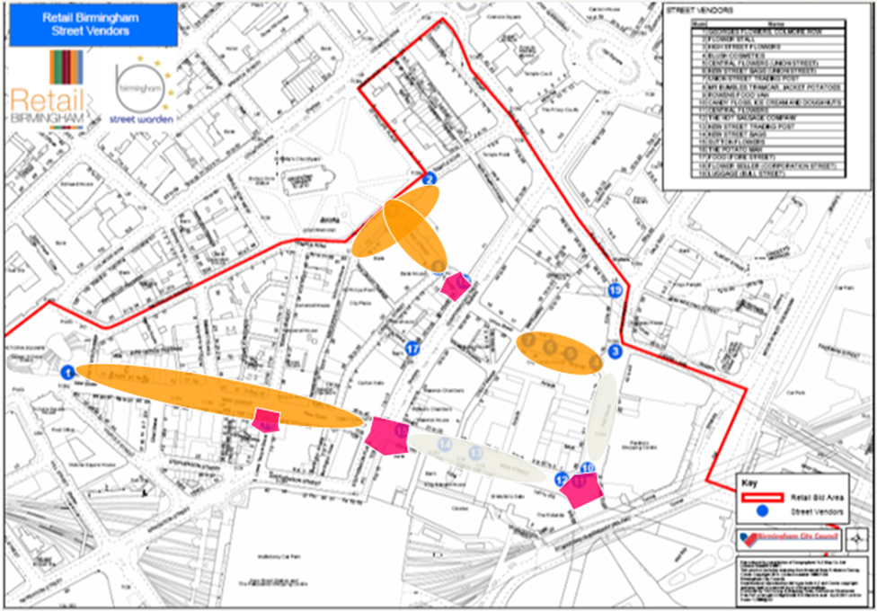
8.0 Recommended Improvement Strategy
8.3 Recommended Improvement Strategy
Based on the findings of the research undertaken for this study, and the conclusions identified in the previous section, the key recommended improvement actions are as follows:
1. Ensure all pitches are in appropriate locations
It is recommended a structured assessment be undertaken of all pitches to ensure they are not breaking any ‘red line’ tests. This includes no stalls directly outside retailer entrances or directly in front of retailer windows, no stalls blocking vistas of all streets and no stalls at the nodes of junctions of key footfall routes or streets, e.g. New Street and High Street, High Street and Union Street etc. This would use a location scoring criteria checklist based on study findings.
The map on the right show the location of the recommend pedestrian priority zones in pink (i.e. no street trading), the premium street
trading zones in red (highest quality street retail environment = highest quality street trading, see also recommendation 3 next page), as well as the general street trading zones in orange.

Slide 40
8.0 Recommended Improvement Strategy
8.3 Recommended Improvement Strategy contd.
2. Street trading to focus on food, drink and day to day convenience based needs, e.g. flowers, newspapers, mobile phone top up & accessories
it is clear that consumers enjoy and use street trading when it’s done well. Consumers have told us very clearly their preferences. They want to buy quality food, drink and convenience items, flowers, newspapers, confectionary and mobile phone top-up, e.g. See Bullring ground floor for reference
3. Premium streets need premium street trading, units, standards and delivery
Birmingham is the UK’s number two city. It’s retail offer is third in the UK (behind Glasgow). There is widespread ambition for the city centre to deliver a world class retail offer and experience.
The existing street trading offer on New Street and High Street is far from that. Traders on these locations need to raise their game significantly to trade there, in order to complement the retail activity.
Put simply, if traders want to trade on Birmingham’s premium retail streets, the quality of goods being sold, the standards of display and the design condition of the stalls needs to be similarly premium at a UK level. Matched by high standards of customer service.
4. Weaker stalls need moving outside core area
If traders don’t have the ambition or ability to become premium street traders, they should be provided with appropriate support and training with the aim of helping them become so. Develop a set of street trading guidelines, best practice and checklists as pro-active positive tools to help improve performance. These can be based on the successful NMTF 400 training material
If, after a period of transition, they fail to achieve required standards (continue to sell poor quality product in an unappealing manner), then they need to be moved outside the core retail heart, e.g. Edgbaston Street or Bull Street.
5. Total clampdown on all pedestrian interference
The Birmingham ‘open air’ retail experience is one of the worst out of all regional centres in the UK. With the utmost of urgency, there needs to be a major and lasting push against pedestrian interference.
The equivalent poor experience doesn’t happen in the West End of London, nor Manchester, Liverpool, Newcastle etc. For information, Newcastle has implemented tight controls under a Public Space Protection Order.
Furthermore the improvement in the indoor shopping experience is magnifying the poor and intimidating retail experience on New Street and High Street.

Slide 41
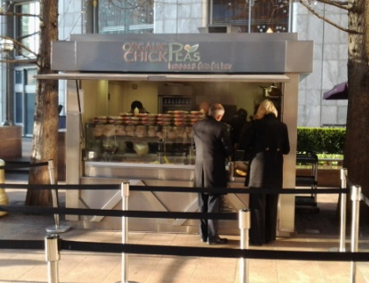
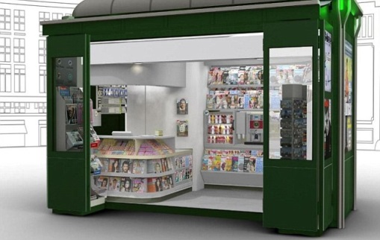
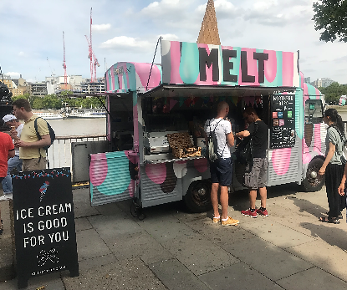
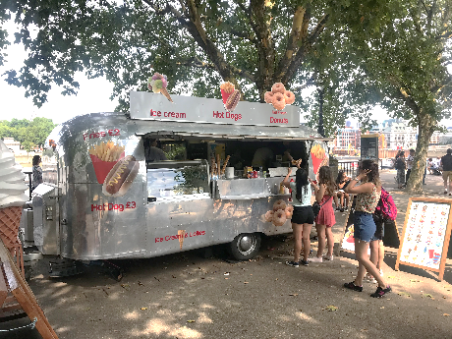
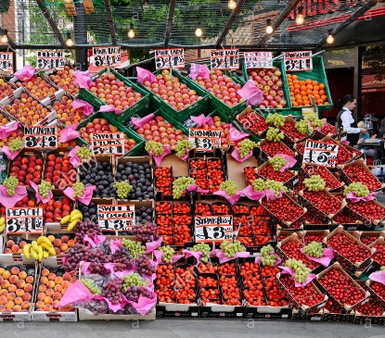
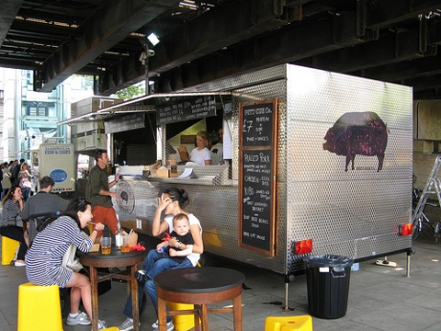
8.0 Recommended Improvement Strategy
8.3 Recommended Improvement Strategy contd.
6. Develop suite of new stall formats
One of the criticisms levelled at street trading from the city centre stakeholders is there is too much inconsistency in how they look. In particular, one or two weak and tired looking old stalls are bringing the whole look and feel of street trading down.
It is recommended that all key stakeholders (council, traders and Retail Birmingham) work together to agree a suite of three or four acceptable stall formats, style, construction, materials and size. Traders should then be given support – (financial if necessary) to invest in new stalls that are appropriate for their preferred product range, are branded Birmingham City Centre Street Trading, and use the same palette of colours.
Consideration should also be given to allowing high quality purpose built street trading vans or caravans.
The images on the right show reference points and inspirations. They are not the recommended format for Birmingham City Centre, which needs to be the subject of a specific piece of work and project group.

Slide 42
8.0 Recommended Improvement Strategy
8.3 Recommended Improvement Strategy contd.
7. Stalls to stay in place but be movable in emergencies
The street trading stalls exist in an inconsistently managed regime where they are supposed to be removed overnight, with some being moved and others not.
This creates inconsistency and uncertainty all round. We recommend a formal position be agreed and adopted where the stalls are permitted to stay in situ overnight, but are removable in the case of emergency or planned major event (e.g. Christmas market).
8. Much stricter management regime needed
Many of the stakeholders we spoke to complained of stalls with merchandise spilling onto the street, or in some cases sprawling product ranges within the stall but with little coherence or relevance to the original core licensed product group.
Poor litter management and general city centre cleansing were often mentioned by stakeholders as also needing significant and urgent improvement.
Similarly, we have been told that a few stalls are sublet, which is against the terms of street trading. The council needs sufficient resource within it’s management regime to quickly enforce against the above examples of poor practise. Repeat offenders should loose their licenses.
9. Street trading offer needs promoting
Once the above improvements have been delivered, it is important the street traders are encouraged to take an active part in wider city centre promotions and initiatives.
Having combined promotions and including street traders in wider city centre initiatives will deliver improved standards, and a cohesive approach. Introducing a new Birmingham City Centre Street Trading brand will also help to improve appeal and trust.

Slide 43
The Retail Group
Informed Solutions
Tel. 0844 209 8480
Web. www.theretailgroup.co.uk
Email. info@theretailgroup.co.uk
Dunnings Oak Offices,
Dunnings Road,
East Grinstead,
West Sussex, RH19 4AT

