Slide 1
Systems that Support Kids
Or…more accurately…
Stating the b****ing obvious!
Or….
Systems that you already have and are probably better than ours
…apologies

Slide 2
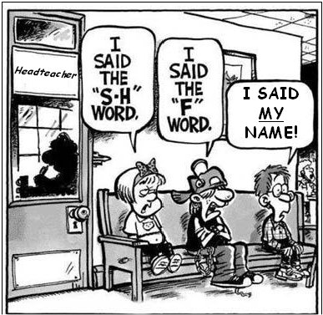
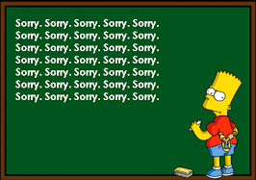
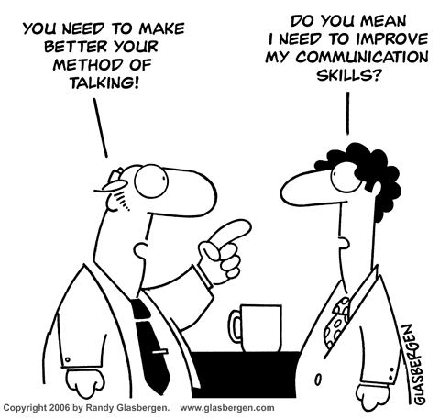
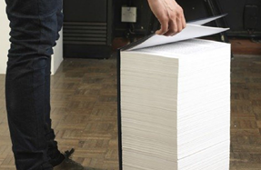
Behaviour Management Records
Introduced electronic records for behaviour management in 2006
Reasons for this included:
Range of staff involved across the school
To celebrate issues and successes…
no matter how small!
Spotting patterns
Variety of records maintained by staff

Slide 3
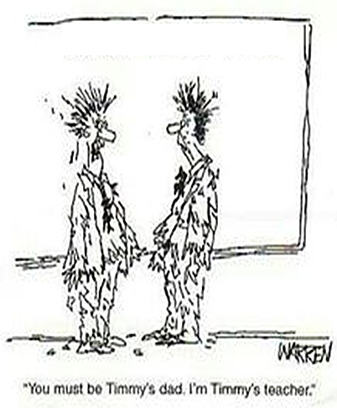
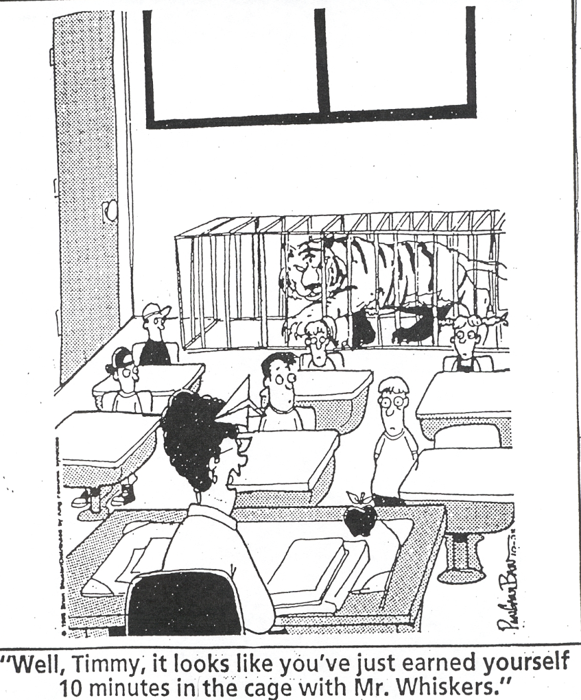
Behaviour Management Records
Of course introducing such a system meant it had to serve a purpose:
Staff needed to see it was actually acted upon
Children needed to be aware of their own records as well as the class. This included the achievements and behaviour
Parents needed to be included in being updated on successes and concerns
Governors needed to be aware of achievements and behaviour across the school
You must be Timmy’s dad. I’m Timmy’s teacher

Slide 4
Behaviour Management Records
Above all else staff need to be assured that this wasn’t just another addition to their workload for the sake of it.
They also needed to be sure it wasn’t some evil master plan to catch them out.

Slide 5
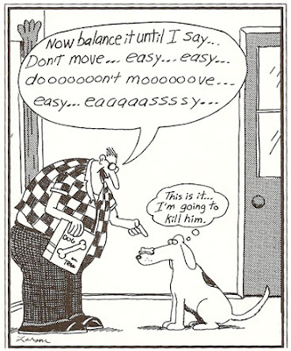
Part 1 A Whole School Approach
Non-negotiables for pupils - respect and being safe
Avoiding dialogue about secondary incident(s)
Addressing behaviour requiring intervention (especially if observed by others!)

Slide 6
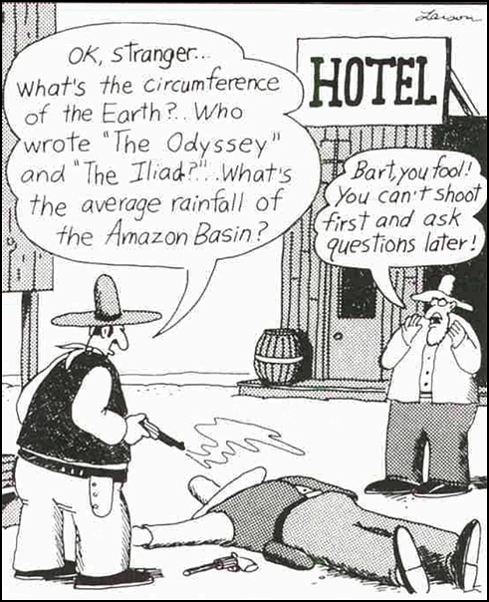
Part 1 A Whole School Approach
Realistic expectations of all
Give an instruction of what you want rather than what you want to stop
No gloating
Acknowledge successes, but don't over exaggerate

Slide 7
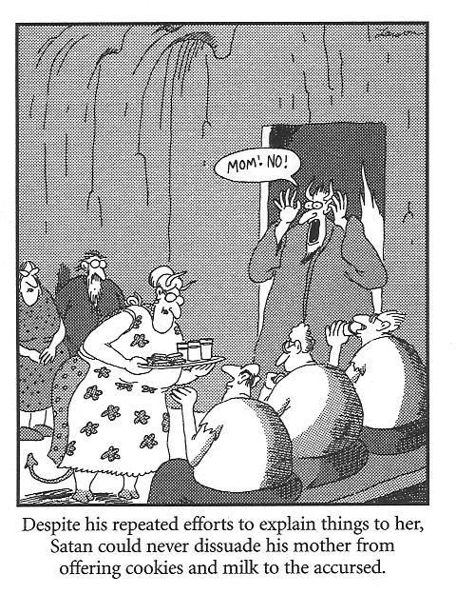
Part 1 A Whole School Approach
Maintain positive relations – every day is a new day!
Even those who make errors deserve a 2nd chance!

Slide 8
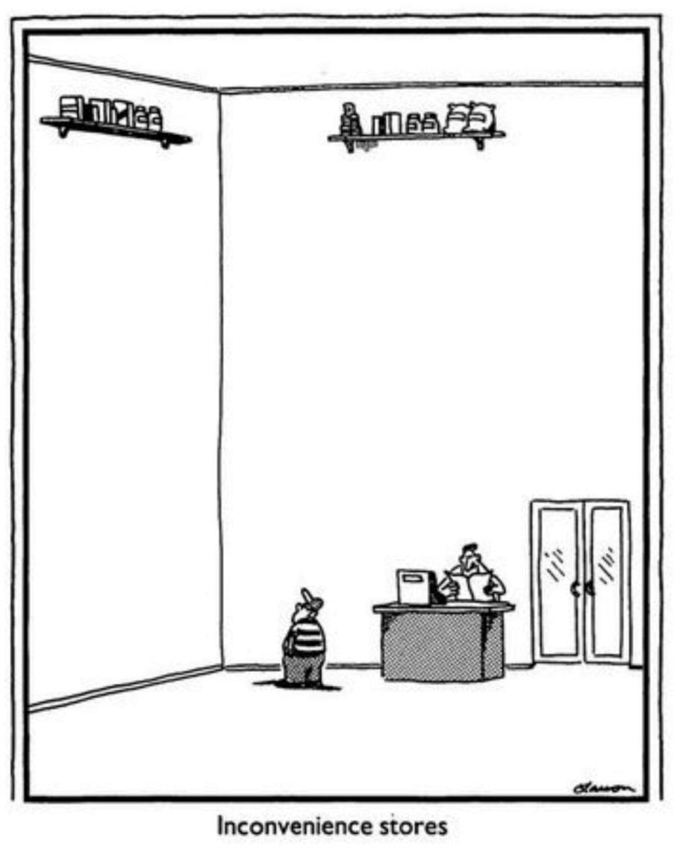
Part 1 A Whole School Approach
Relationship between the behaviour and the consequences
Reasonableness of the consequence
Respect needs to be retained

Slide 9
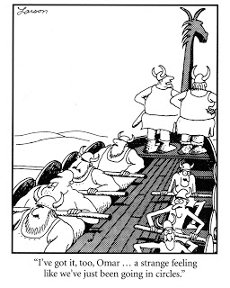
Part 1 A Whole School Approach
Talk up the collective!
Budgets for Phases and fines!
Community Service!

Slide 10
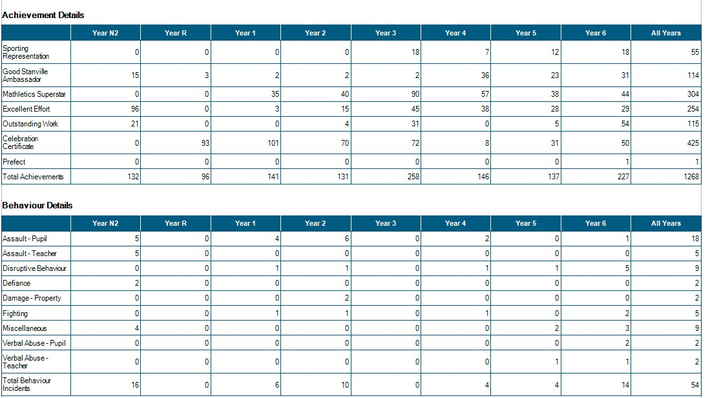
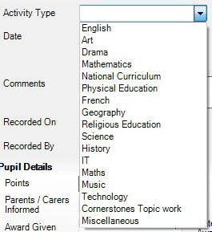
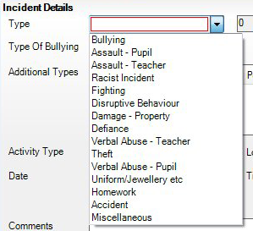
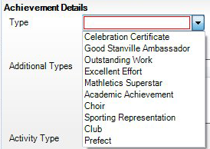
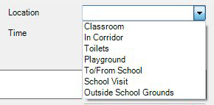
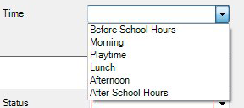
Part 2 - Behaviour Management Records
Benefits:

Slide 11
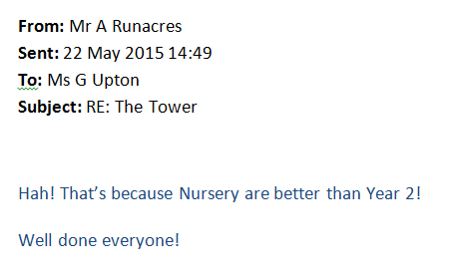
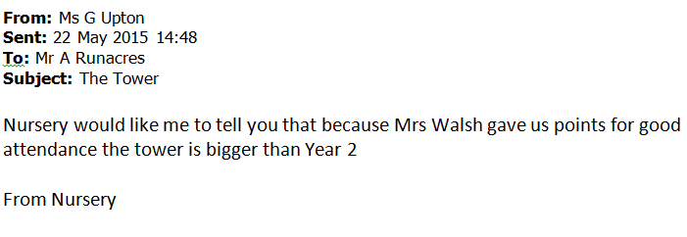
Part 2- Behaviour Management Records
An example of how it does make a difference…
Email conversation between the Nursery class and me from the summer term:

Slide 12
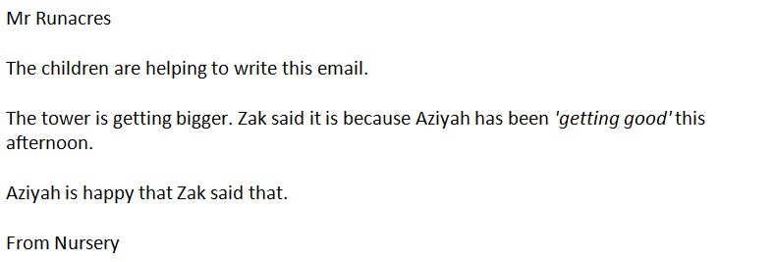
Part 2 - Behaviour Management Records
Another example of how it does make a difference…
Email conversation with the Nursery class:

Slide 13
Part 2 - Behaviour Management Records
Another example of how it does make a difference…
Email message from the Nursery class teacher:

Slide 14
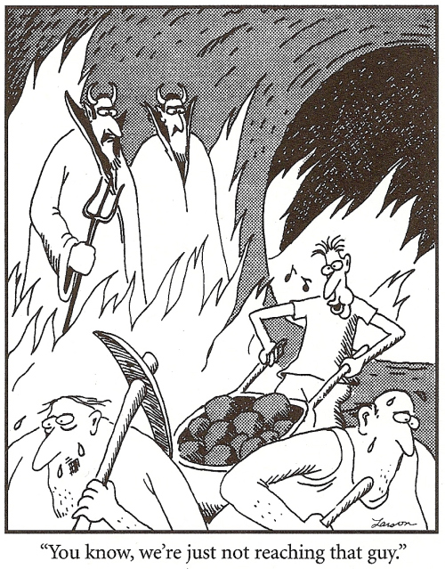
Part 3 Supporting Individuals who need a little extra!
IBPs
1:1 discussion of behaviour concerns
Use a picture to illustrate and to also gently mirror the behaviour in the picture
Must be something that is achievable!

Slide 15
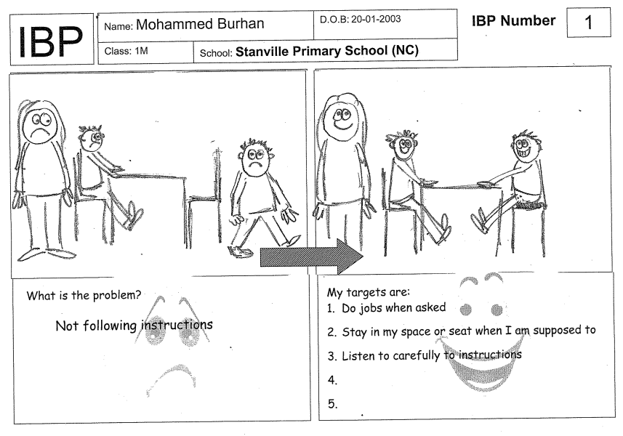
Part 3 Supporting Individuals who need a little extra!

Slide 16
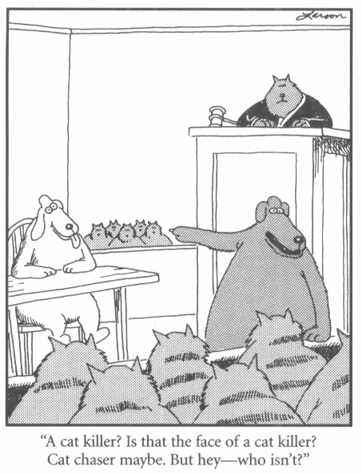
Part 3 Supporting Individuals who need a little extra!
Expectations of staff – realistic, fair and daily (85% level in sessions)
Expectations of parents – partnership
Expectations of child
Commitment and consistency
Share successes and discuss the issues
Record only the positives

Slide 17
Part 3 Supporting Individuals who need a little extra!

Slide 18
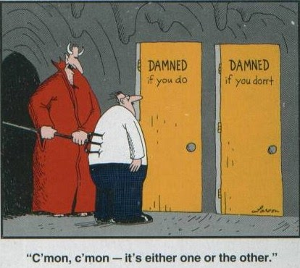
Part 3 Supporting Individuals who need a little extra!
Helping them to make right choices
Making them realise they decide quite a lot of what happens
Limiting the options to just 2

Slide 19
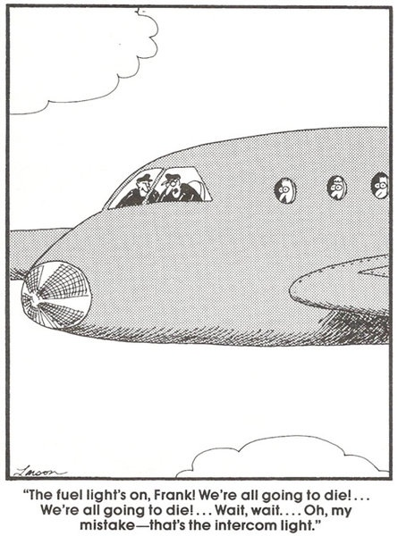
Part 3 Supporting Individuals who need a little extra!
Communication is key:
With the staff
With all family
With the child
Communication is key:
Record keeping
Text messages
Termly reports
Face to face

Slide 20
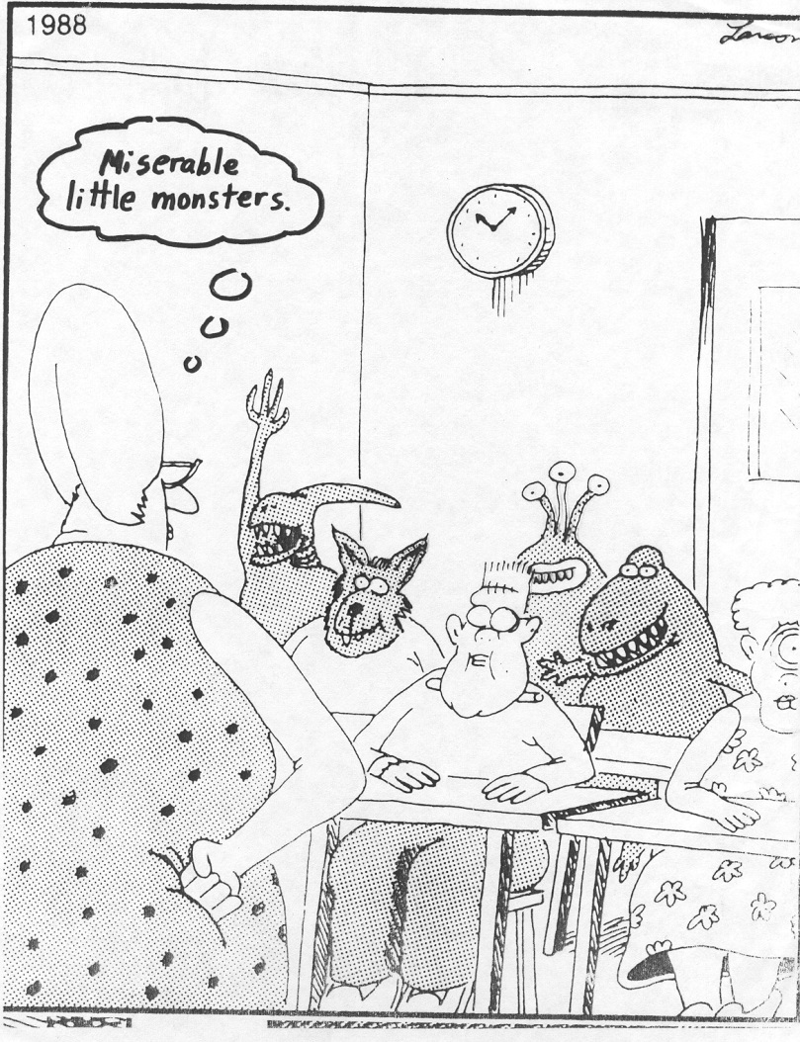
To conclude…
Whatever we may think of them at times…
they are children
Although this can be difficult!
Very difficult!

